Slide 1
Validation of Model Parameter Relationships
2023/08/29
Yu Li

Slide 2




Interpretation of the relationship between Spo2 and parameters
ΔA has two expansion methods, one is to expand according to the chromophe, and the other is to expand according to the μa of the layer

Slide 3
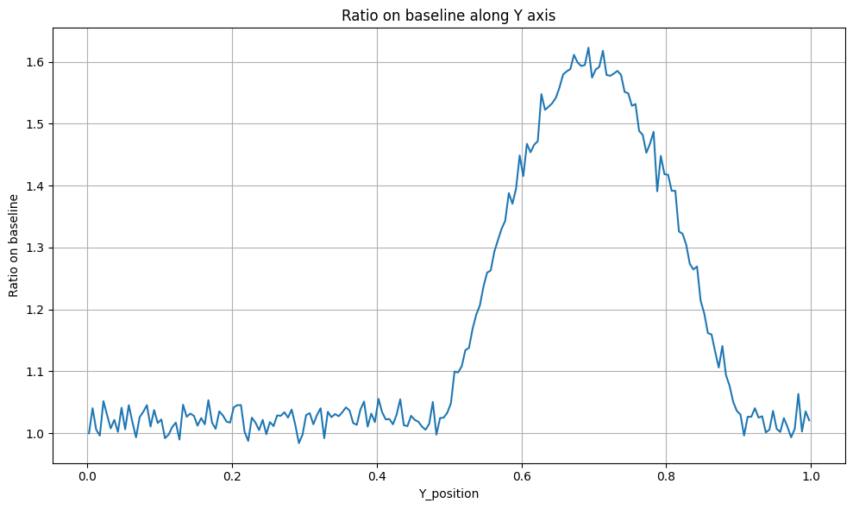
Ratio is defined as the ratio of CHbO2/CHb.
Spo2 is a function of ratio, which means, in one cycle, the blood oxygen ratio does not change, and the spo2 does not change.
The overall μa is a formula related to β, ratio and Hb concentration.
Fitting the β curve of blood vessel volume change

Slide 4
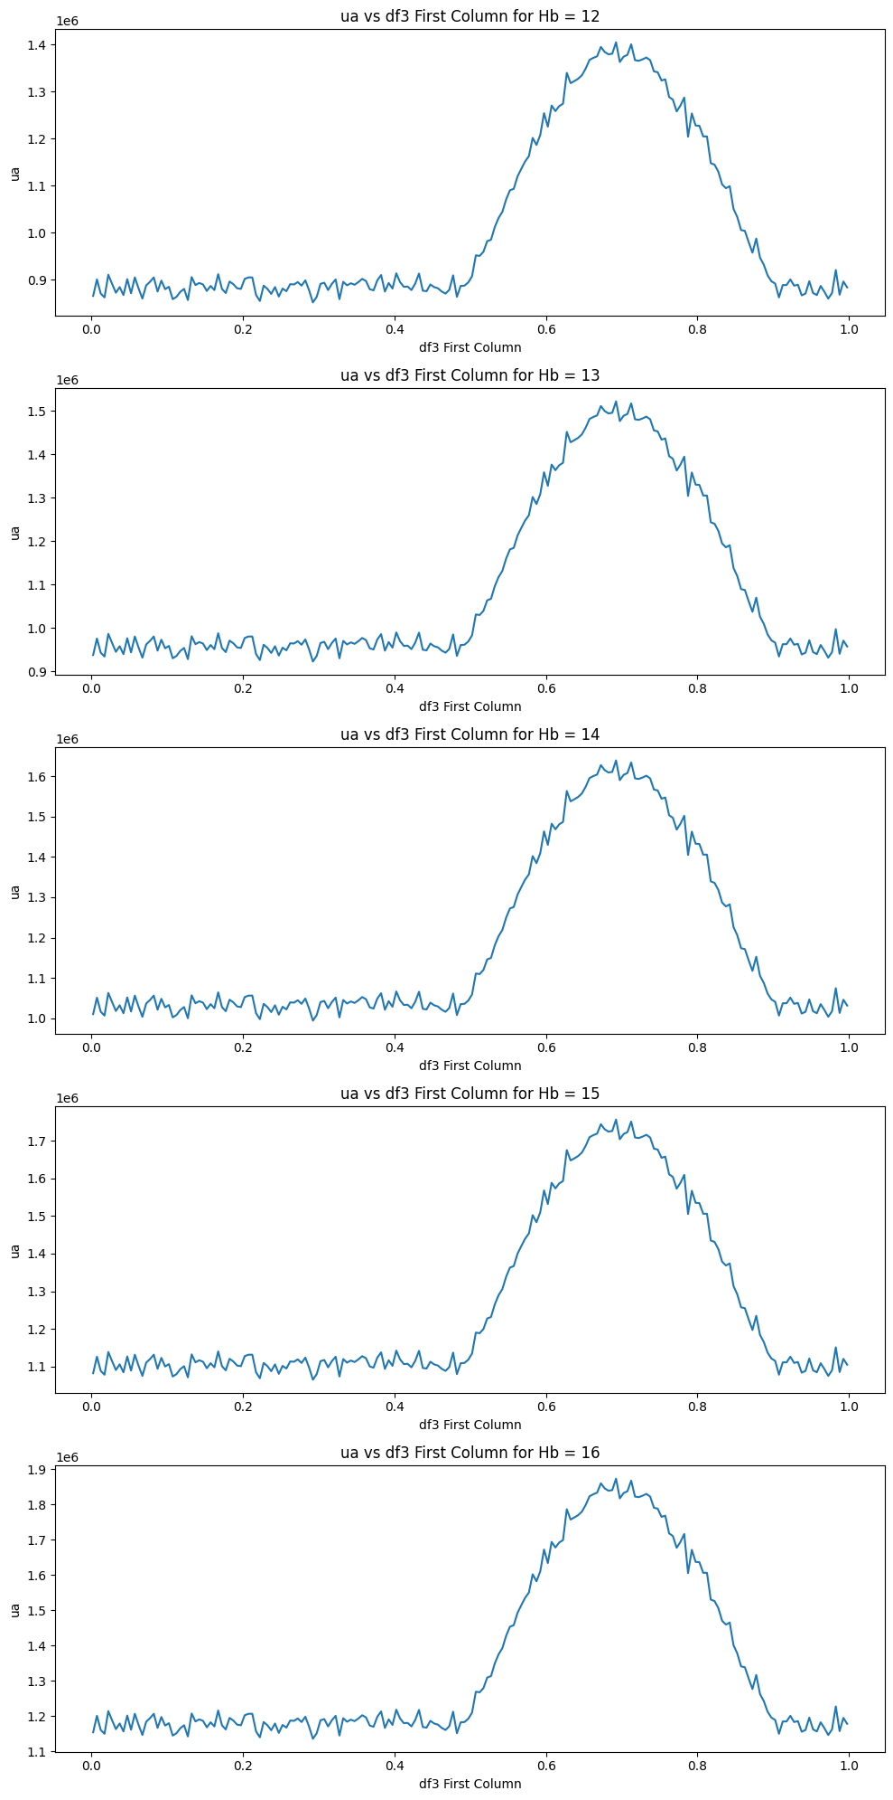
General Hb Concentration Attempts
Newborns: 17-22 g/dL (grams per deciliter)
Infants: 9-14 g/dL
Children: 11-16 g/dL
Adult males: 14-18 g/dL
Adult females: 12-16 g/dL
Pregnant women: 11-16 g/dL
Use the data of Hb concentration between 12-16 to do a test one by one, different concentrations represent different individuals.

